Slide 1
Tetris
OBJECT - ORIENTED PROGRAMMING
Start Slide

Slide 2

Group Members
ITITWE22106
ITITIU21228
ITITWE23042
Nguyễn Phước Thịnh
Trịnh Minh Khoa
Trần Lê Minh Quân

Slide 3


Table of Content
Game Rules
Class design
Demo

Slide 4
Game Rules
A TEAM
Start Slide

Slide 5
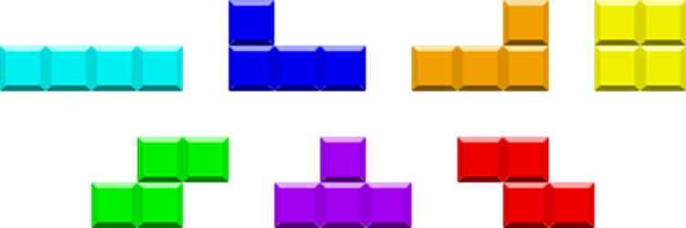
Game Rules
Items
a. Mino_Bar e. Mino_Z1
b. Mino_L1 f. Mino_T
c.Mino_L2 g. Mino_Z2
d.Mino_Square
Figure 1 : The designed items

Slide 6
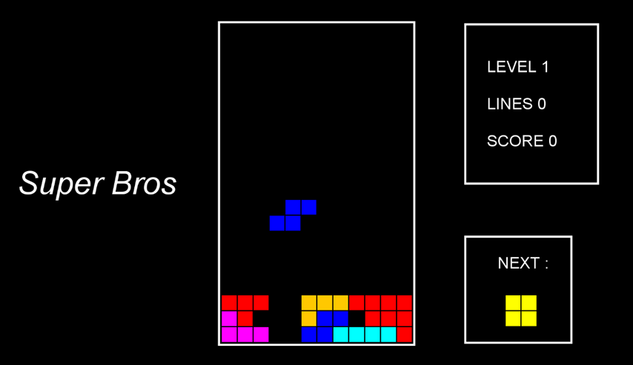
Game Rules
Figure 2.The Game Interface

Slide 7
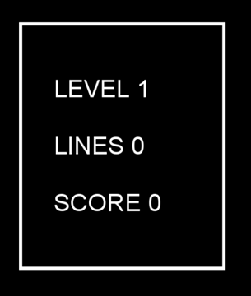
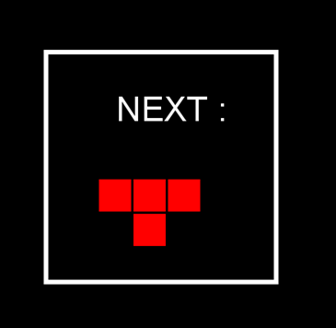
Game Rules
Figure 3 : The Status Panel
Figure 4 :The Data Frame(Next Brick Panel)

Slide 8
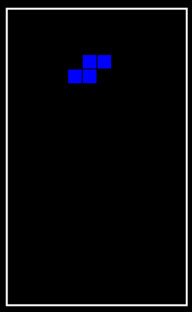
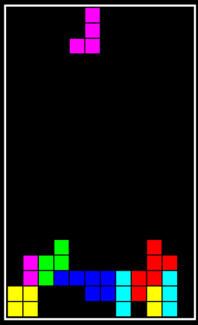
Game Rules
Figure 6: GamePanel
Figure 5 : GamePanel

Slide 9
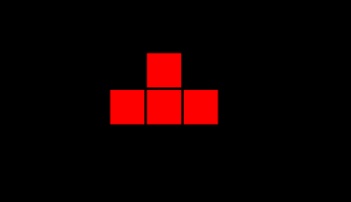

Game Rules
Figure 8: Mino after rotation
Figure 7: Mino before rotation

Slide 10
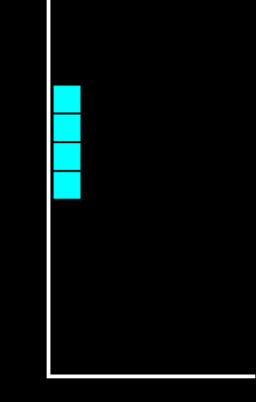
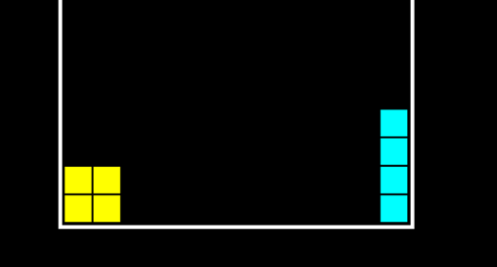
Game Rules
Figure 10: Mino cannot rotate when collide the floor
Figure 9: Mino_Bar cannot rotate when collide the wall

Slide 11
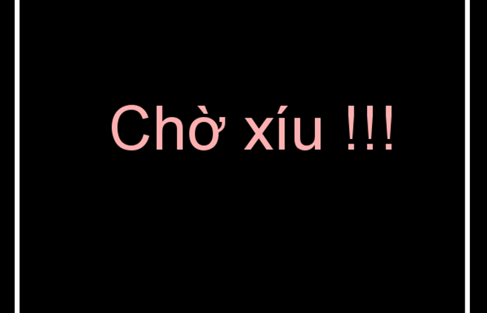
Game Rules
Game Pause
Player can take a break in the middle of the game by pressed the key to pop up the Pause Panel
Figure 11 : PauseScreen

Slide 12
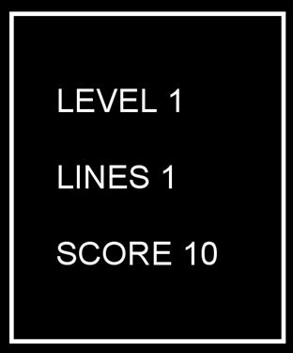
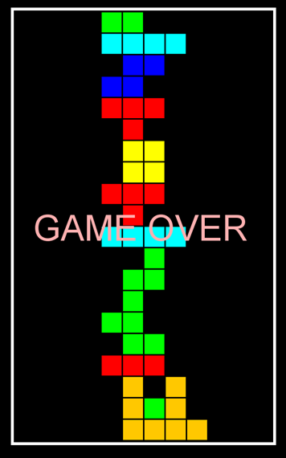
Game Rules
Score
After the perfect 12 Block in line disappear , you will receive for each 1 + line and the score will be summed for 10 points.
Game Over
When the brick cannot go down anymore the game will be over , then the Game over Panel(figure 7) will pop up and stop the game
Figure 11 : Game Over screen

Slide 13
Class Design
A TEAM
Start Slide

Slide 14


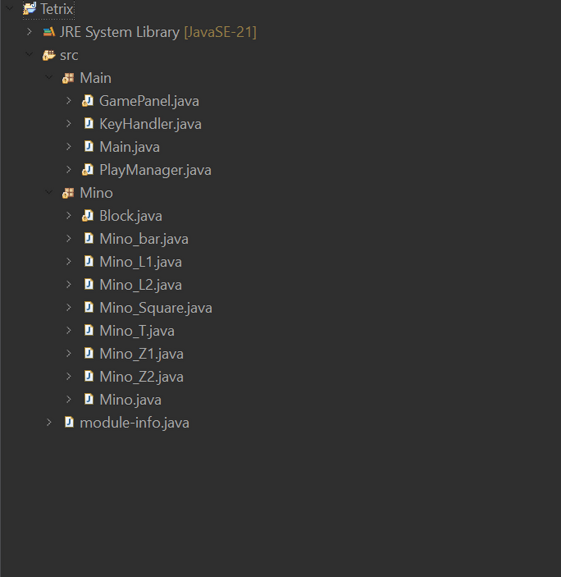
Class Design
how the core game work that 2 class the GamePanel and PlayManager
Figure 12: Class design

Slide 15
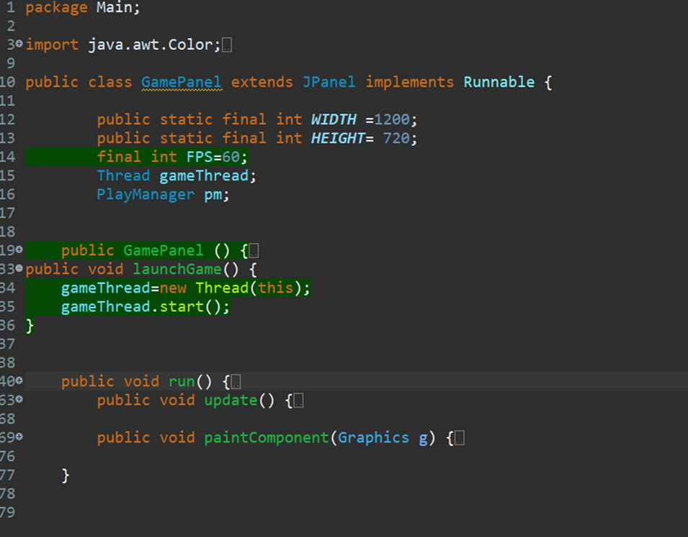
Game Panel Class
Able game loop functionality. This class manages the graphical user interface (GUI), game loop, and interactions with other game components.
Figure 14: GamePanel class

Slide 16
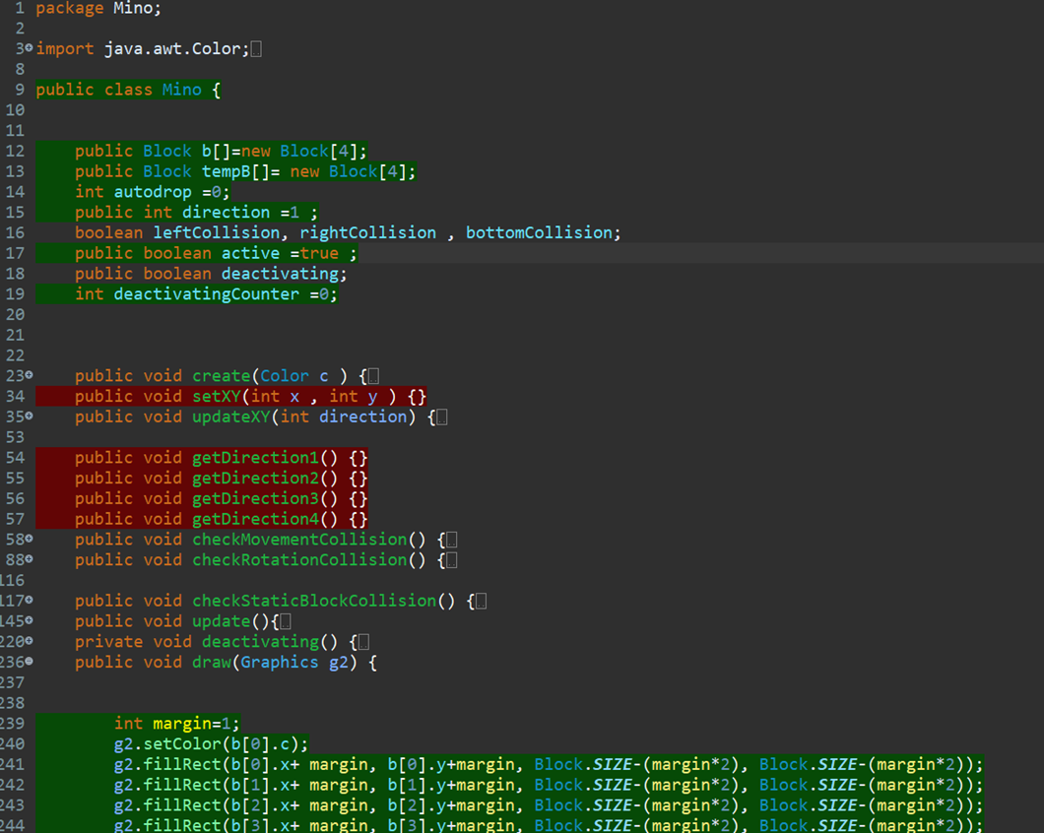
Mino Class
oBlocks:
o Movement and State:
o Collision Flags:
Figure 14: GamePanel class

Slide 17
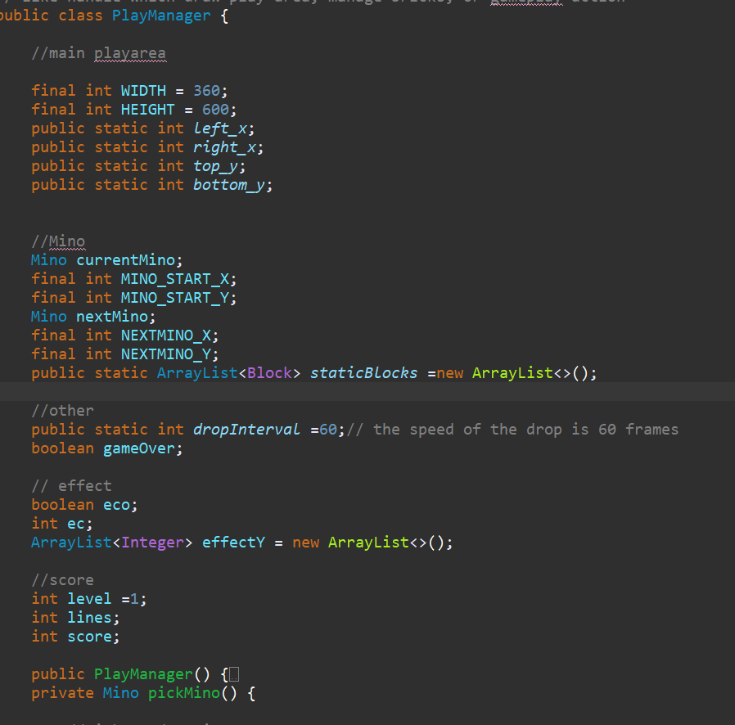
PlayManager Class
The PlayManager class serves as the primary handler for gameplay mechanics, including managing the play area, controlling Tetris pieces (Mino), and updating the game state. It is responsible for drawing the game area, managing static blocks, handling gameplay actions, and providing visual effects and scoring.
Figure 15: PlayManager class

Slide 18
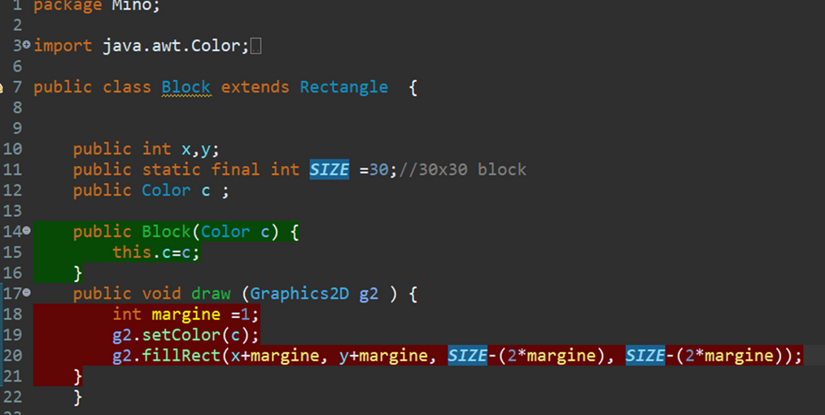
Block Class
Which extends Rectangle, represents an individual square unit that makes up a Tetris piece (Mino) or forms part of the static blocks on the playfield. It is a fundamental building block of the game.
Figure 16: Block class

Slide 19
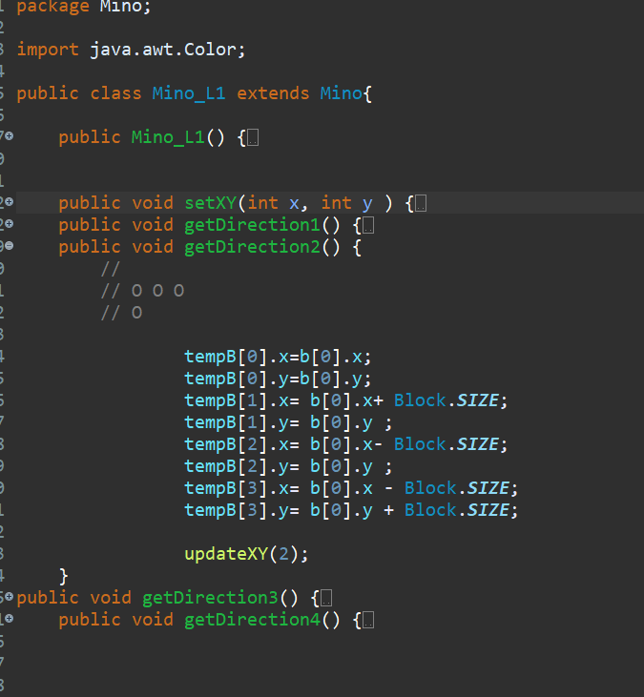
All Mino Class
Which were built the same and it need to take 1 block out to be the static block and all other 3 Blocks around it will be made base on the data of that static Block
Figure 17: Mino_L1 class

Slide 20
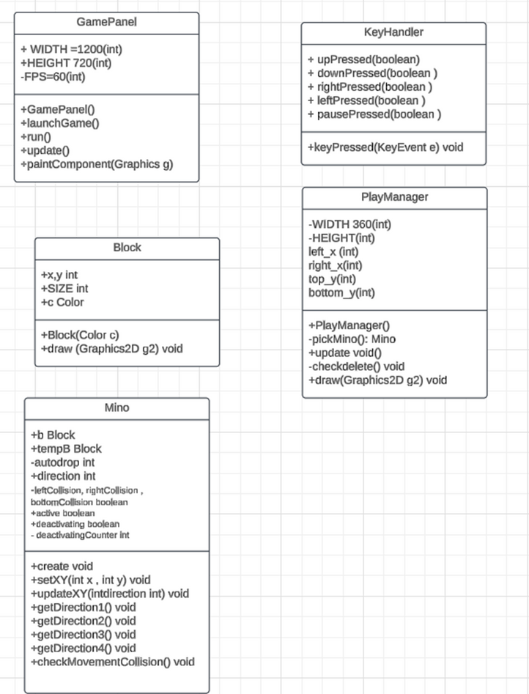
Figure 18: Project UML

Slide 21
Demo
A TEAM
Start Slide

Slide 22
Thank You
FOR YOUR ATTENTION
Start Slide

